Slide 1
[NAME OF STUDENT]
[Student]
Portfolio
[DATE CREATED]
[NAME OF PRIMARY SCHOOL]

Slide 2
What I’ve accomplished
[NAME OF STUDENT]
(Motivation) Good morning, everyone. My name is [Your Name], and today I'm thrilled to present my innovative project developed using Pygame. The motivation behind this project was to create an interactive and educational game that engages children in the Stroop test, a cognitive exercise known for its ability to measure reaction time and attention.
(Define Problem) My problem statement is to design a game that challenges kids to quickly and accurately identify colors, overcoming the interference caused by incongruent color words. The aim is to create an enjoyable learning experience that not only tests reaction times but also enhances cognitive flexibility.
(Ideate Approach) To address this challenge, I ideated a concept where color words would be displayed on the screen, but the font color of each word would be different from the word itself. For instance, the word "red" might be written in blue font. The players' task is to quickly identify and select the color of the font, not the actual word, promoting rapid cognitive processing and attention.
(Create Solution) Leveraging the Pygame library, I implemented the solution, featuring a dynamic spawning mechanism for color-word combinations and an interactive user interface. The game rewards players for correctly identifying the color of the font while penalizing errors and slow responses. A timer adds urgency, and players progress through levels by achieving a set number of correct identifications or a high score. The game also includes a defined game over condition to provide feedback and encourage replayability. The result is a functional and visually appealing game that aligns with the initial goal of providing an enjoyable learning experience for children while challenging their cognitive abilities with the Stroop test.
2
Notes:
Poppins Light – 18 size

Slide 3
[NAME OF STUDENT]
Process Flow
Create an interactive game to test kids' reactions using the Stroop test.
Define Problem
Develop a concept where words are displayed in incongruent colors, and the player must identify the color, not the word.
Ideate Approach
Using Pygame, design a main game loop presenting words written in colors that don't match their meaning. Players earn points for accurately identifying the color, not the word. Increase the challenge by speeding up the presentation of words and colors.
Create
Solution
3
Notes:
Poppins Light – 18 size

Slide 4
[NAME OF STUDENT]
State Flow
Scoreboard
This flowchart shows how the transition between the different states. For instance, after seeing the scoreboard, players can choose to start their game and it will naturally move from ready to question to answer for the player to write an answer. Results will be shown immediately. A final winner screen will show who won the game.
Ready
Gameplay
Result
Winner
4
Notes:
Poppins Light – 18 size

Slide 5
[NAME OF STUDENT]
Python Concept
Pygame is a set of Python modules designed for writing video games. It provides functionality for creating windows, handling events like key presses, and drawing graphics on the screen.
Pygame
Random library provides functions for generating random numbers. This can be useful for scenarios where randomness is required, such as selecting questions or shuffling elements in a game.
Random
Time.sleep() function causes the program to pause for a specified number of seconds. It's commonly used to introduce delays in code execution, which can be useful in scenarios like creating countdowns or simulating time-based events.
Time.Sleep
5
Notes:
Poppins Light – 18 size

Slide 6
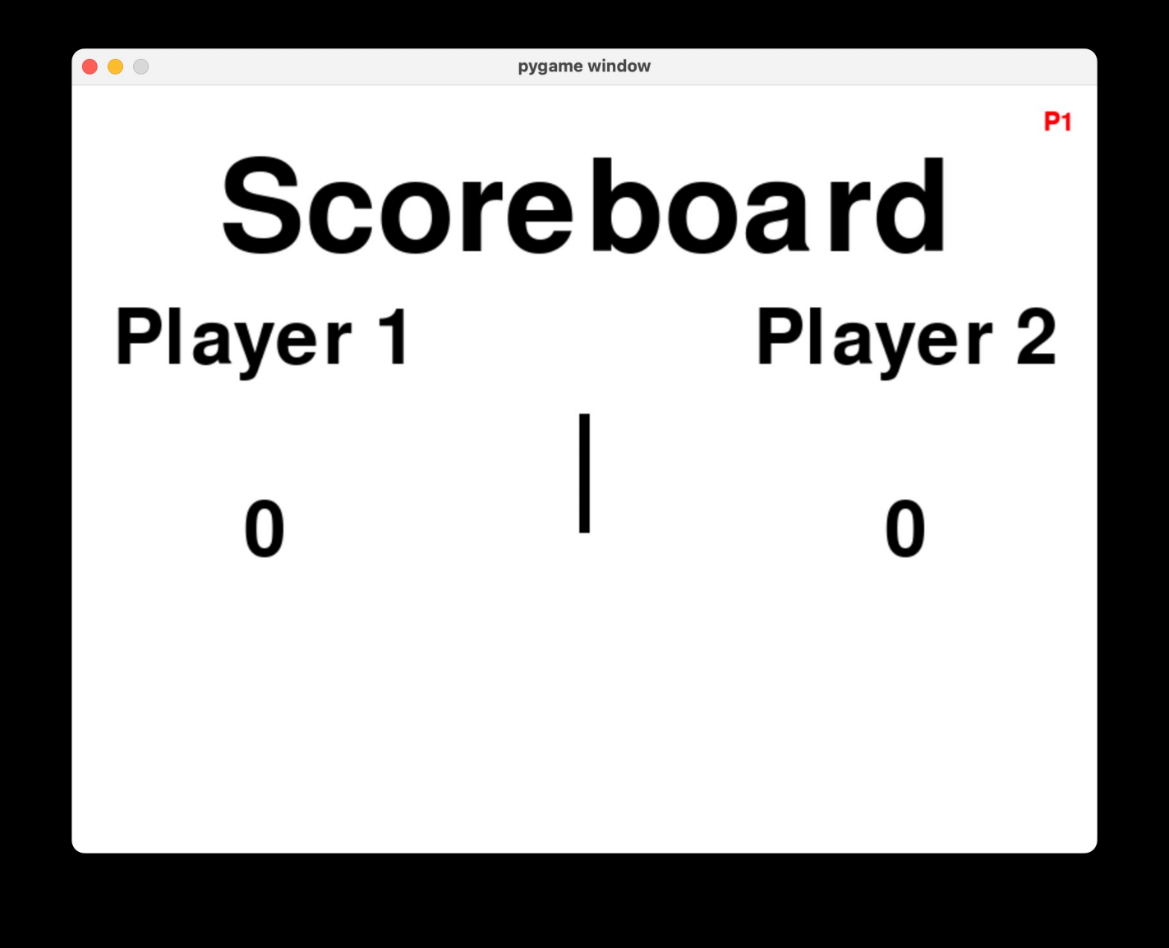
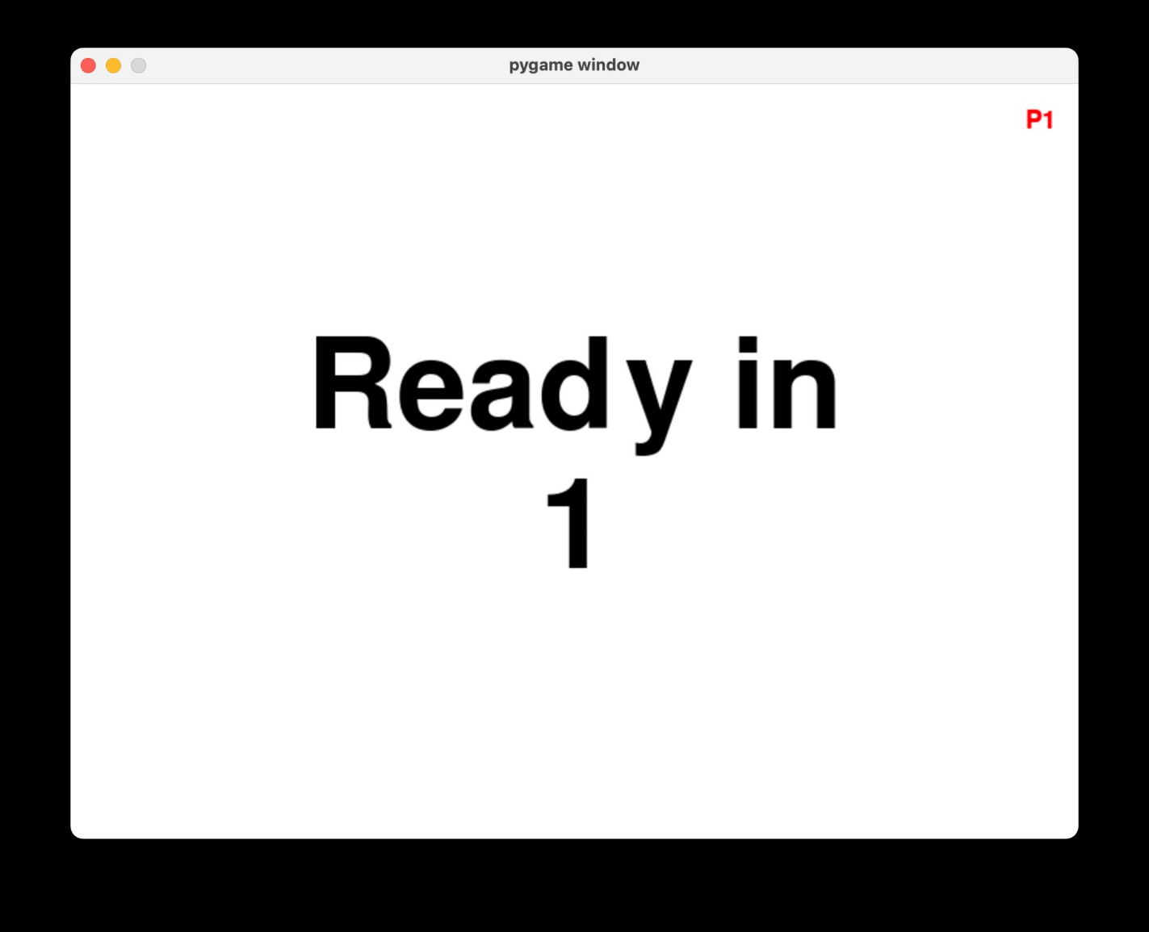
[NAME OF STUDENT]
Mock Screens
Ready In
1
Description
Description
Scoreboard Screen
Ready Screen
6
Notes:
Poppins Light – 18 size

Slide 7
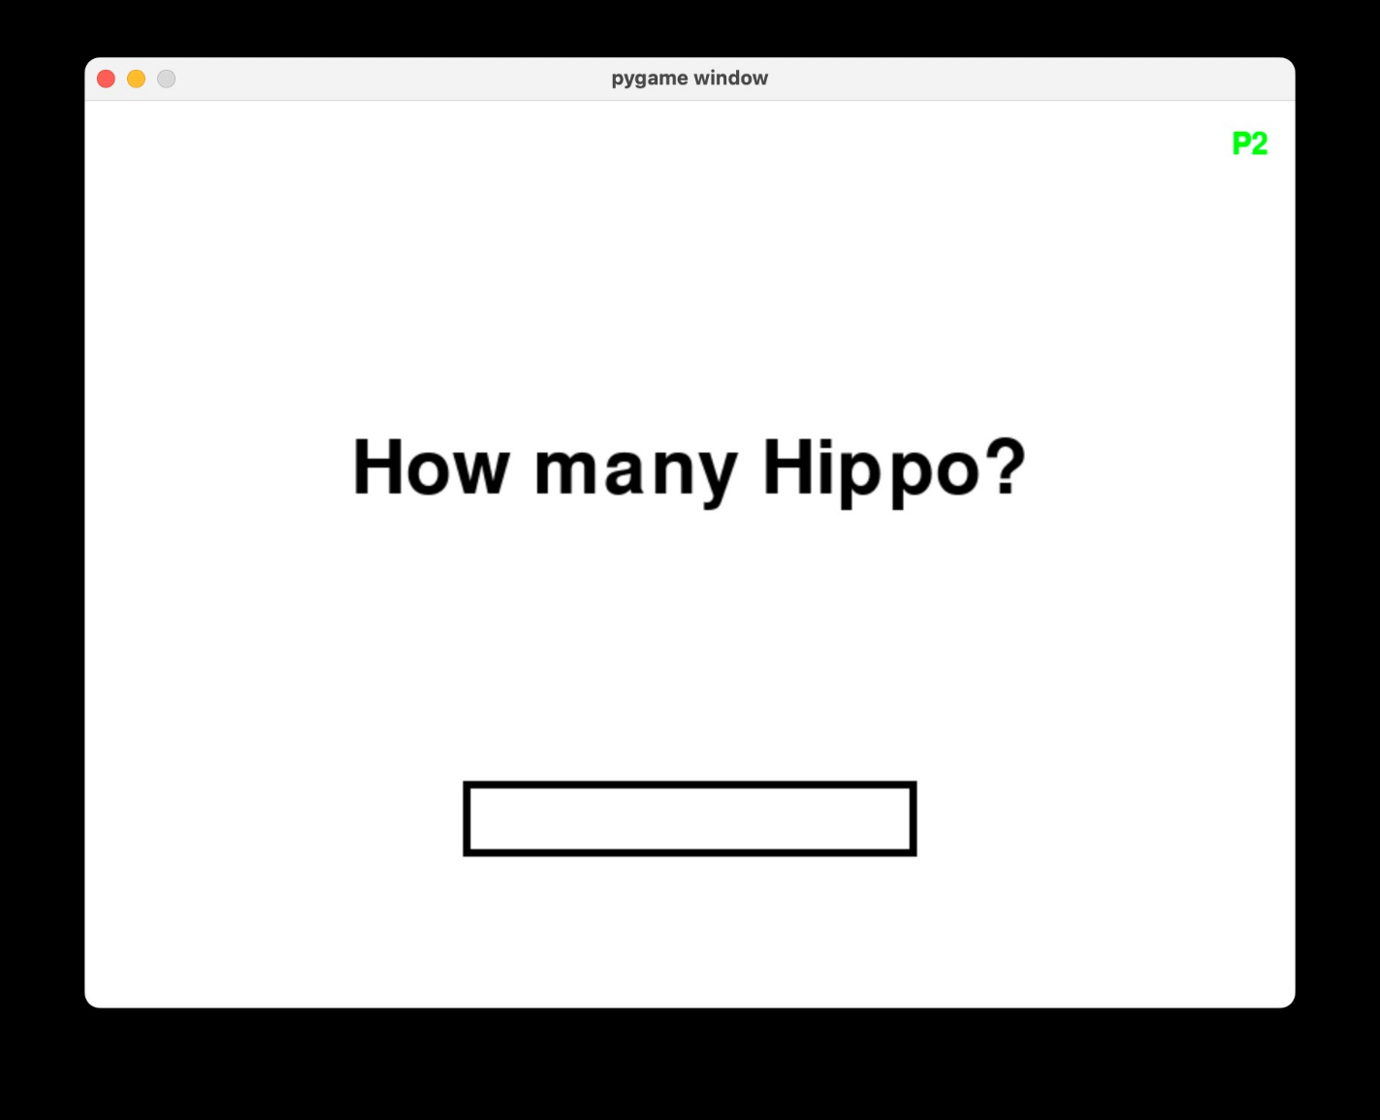
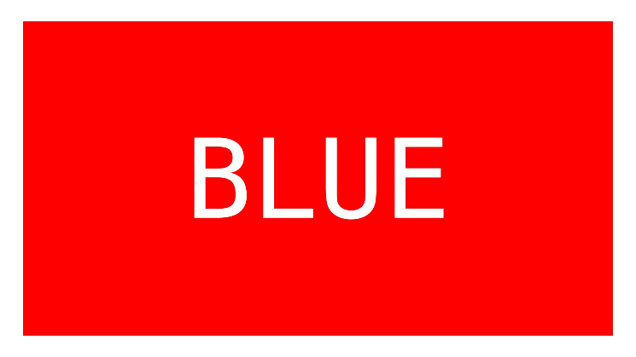
[NAME OF STUDENT]
Mock Screens
Score: 0
Time: 100
Description
Gameplay Screen
7
Notes:
Poppins Light – 18 size

Slide 8
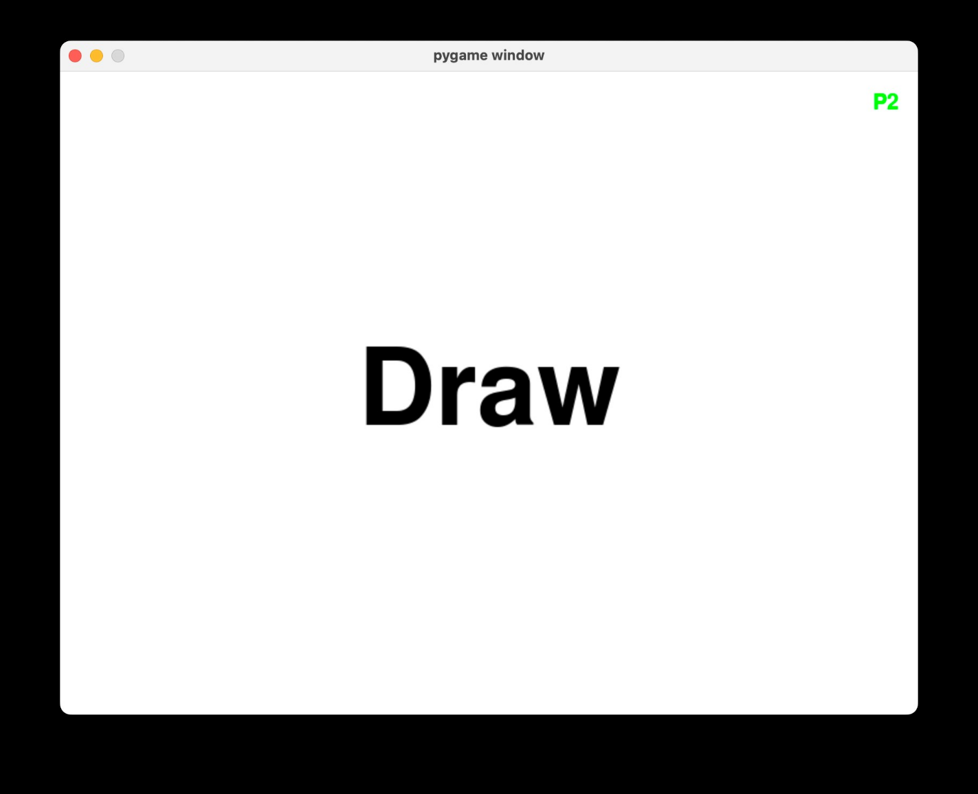
[NAME OF STUDENT]
Mock Screens
You scored 1
Player 1
Wins!
Description
Description
Result Screen
Winner Screen
8
Notes:
Poppins Light – 18 size

Slide 9
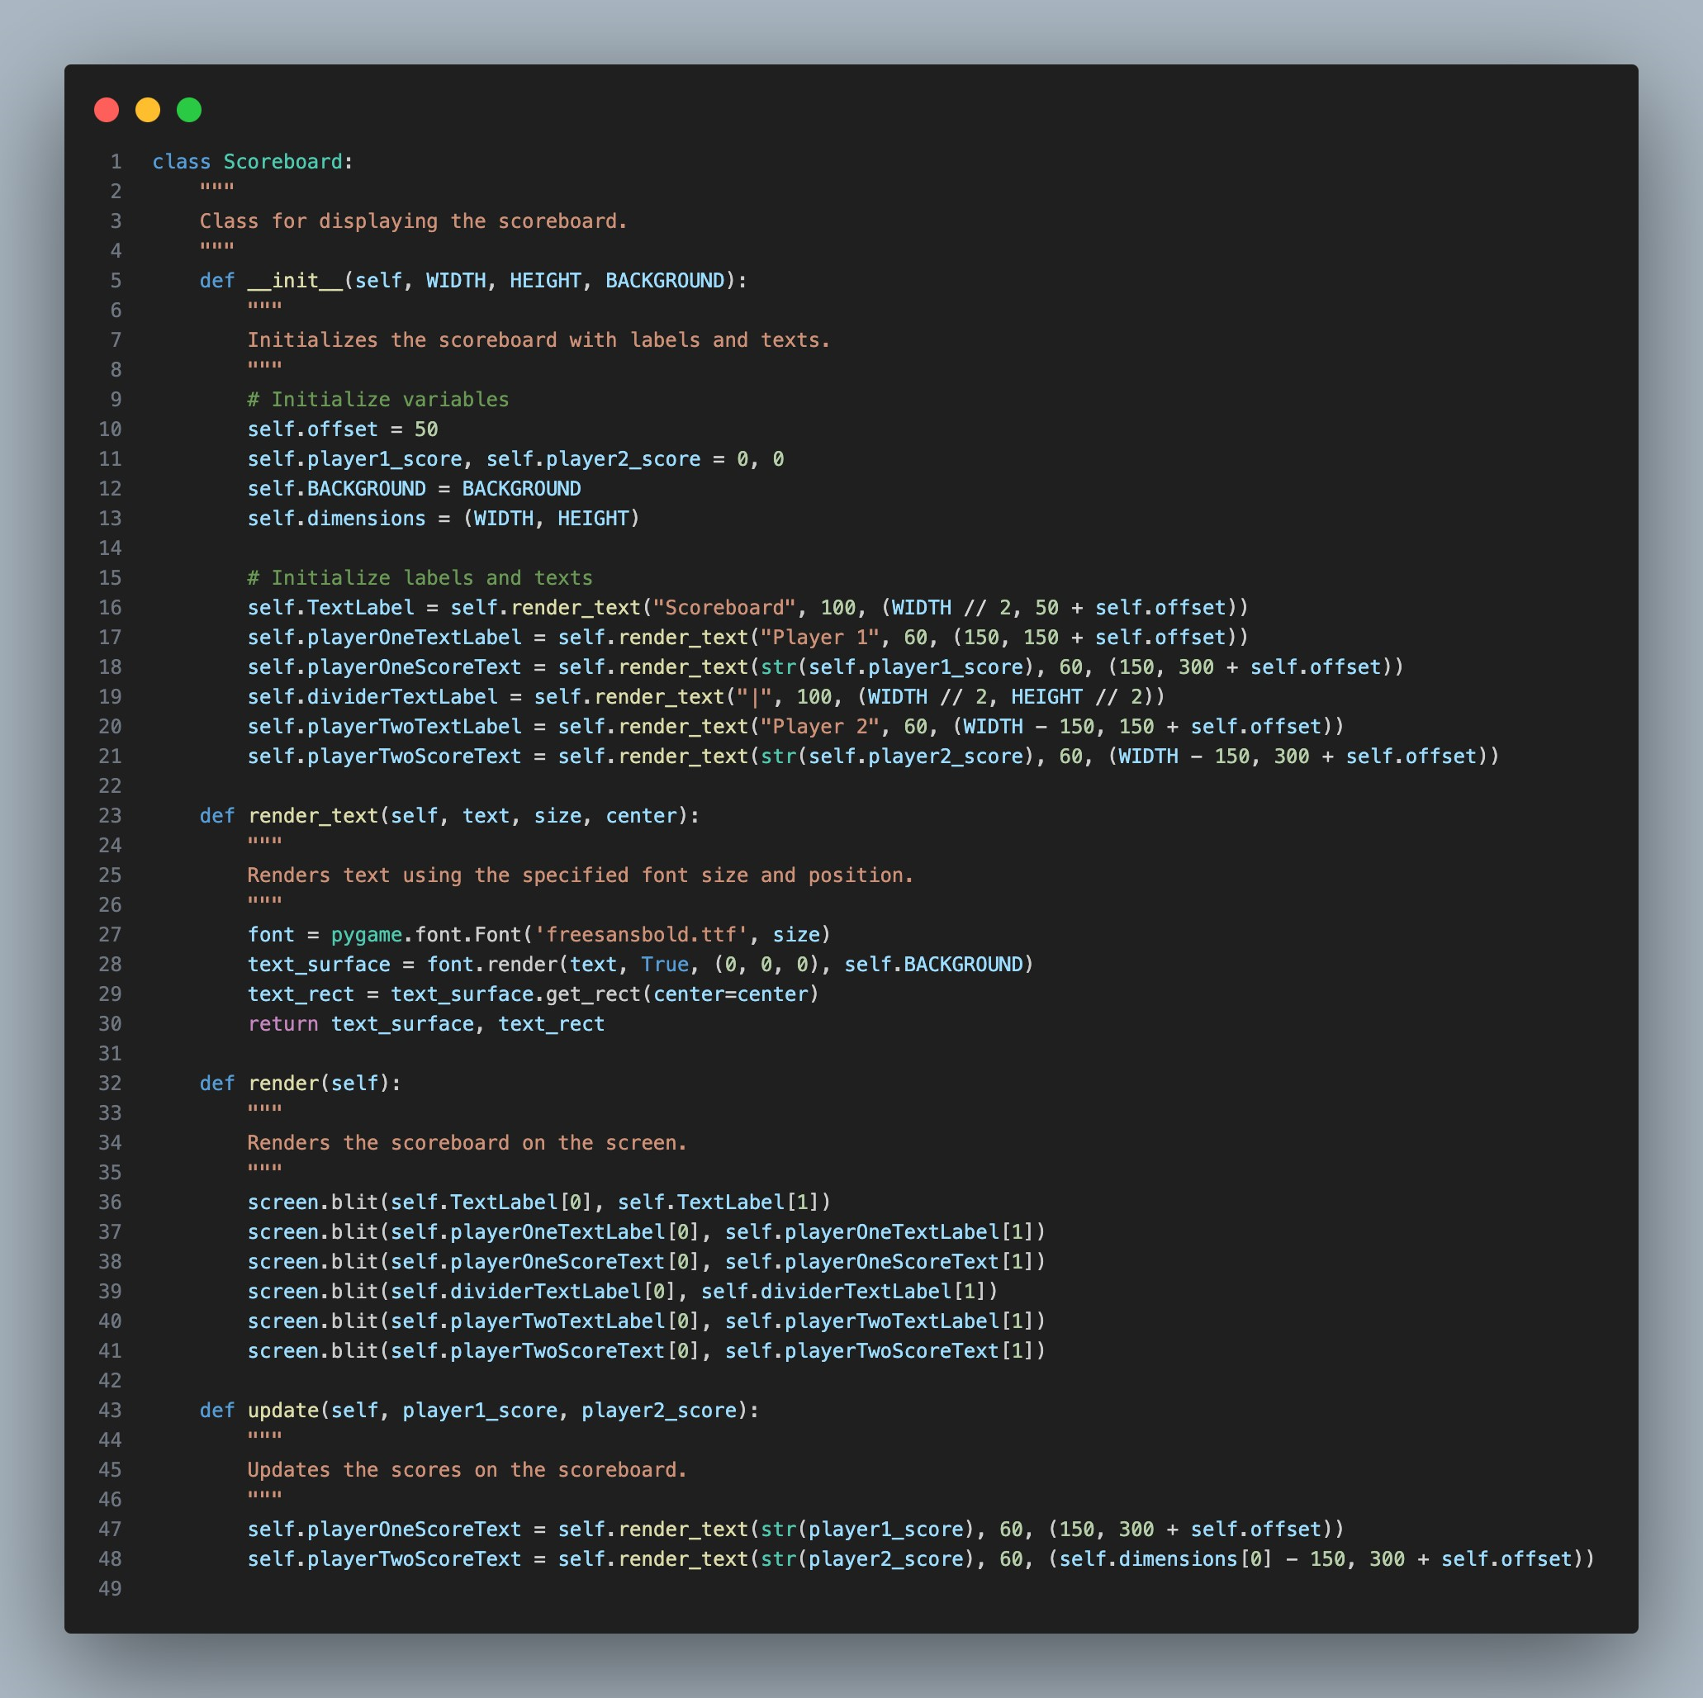
Scoreboard Screen
Displays player scores and labels.
Provides an overview of the current game state.
Elements include player names and their respective scores.
9
Scoreboard Screen
Notes:
Poppins Light – 18 size

Slide 10
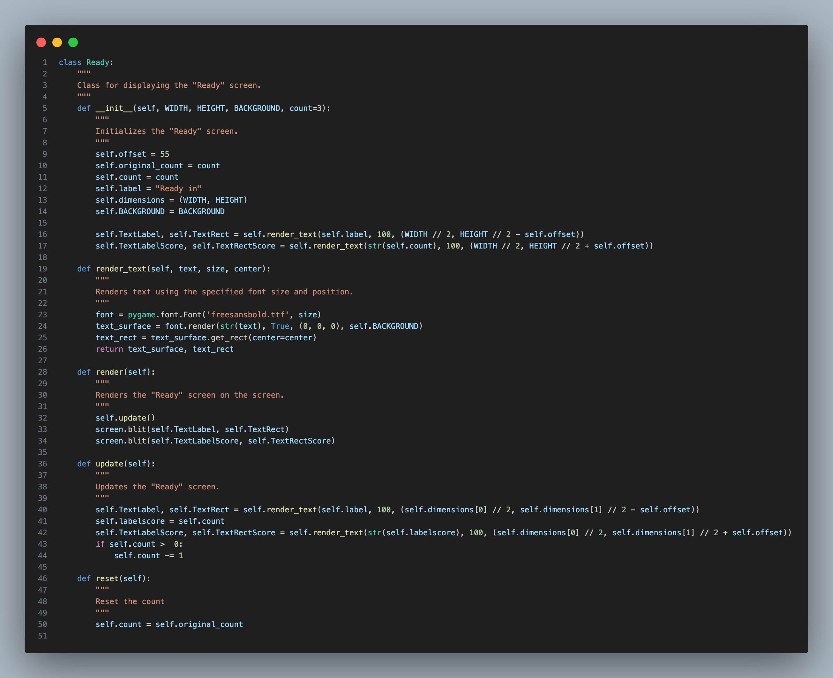
Ready Screen
Counts down to the start of the quiz.
Presents the label "Ready in" and the countdown timer.
Prepares players for the upcoming question.
Ready In
1
10
Ready Screen
Notes:
Poppins Light – 18 size

Slide 11
Y`
Gameplay
If Time Left > 0?
No
0
Loads the next question for every correct response
If wrong answer is given or time runs out, end gameplay.
Yes
No
Is Answer Given?
Yes
Is Answer Correct?
No
Yes
Increase Score by 1
Load next Question
Score: 0
Time: 100
Result Screen
Description
11
Gameplay Screen
Notes:
Poppins Light – 18 size

Slide 12
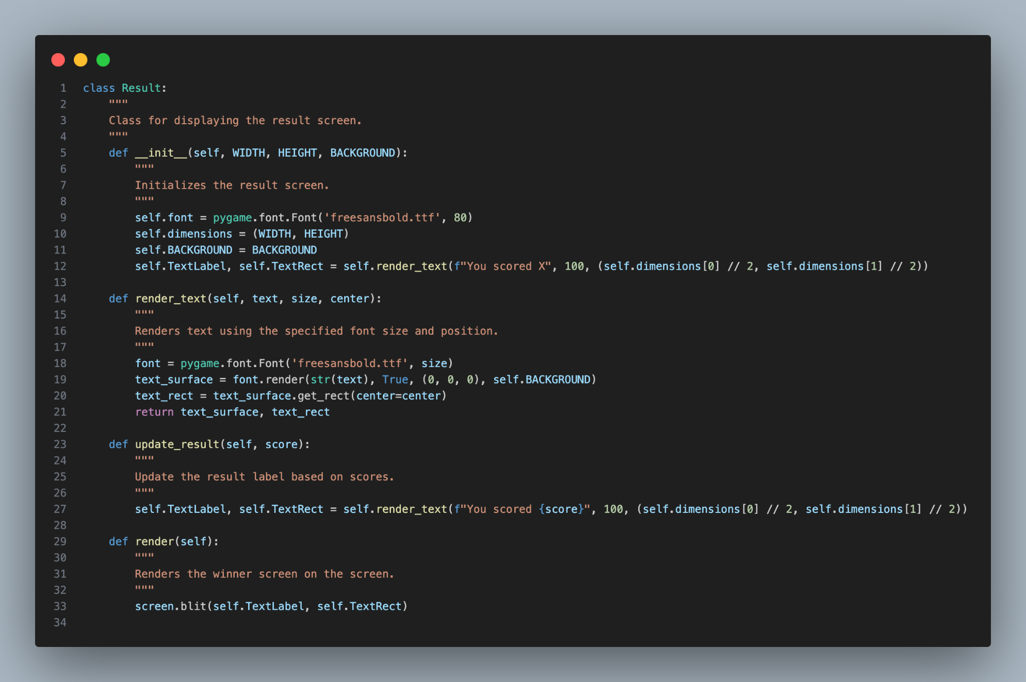
Result Screen
Shows the outcome of the player's answer.
Indicates whether the answer was correct or not.
Presents the label "You scored" and the score.
You scored 1
13
Result Screen
Notes:
Poppins Light – 18 size

Slide 13
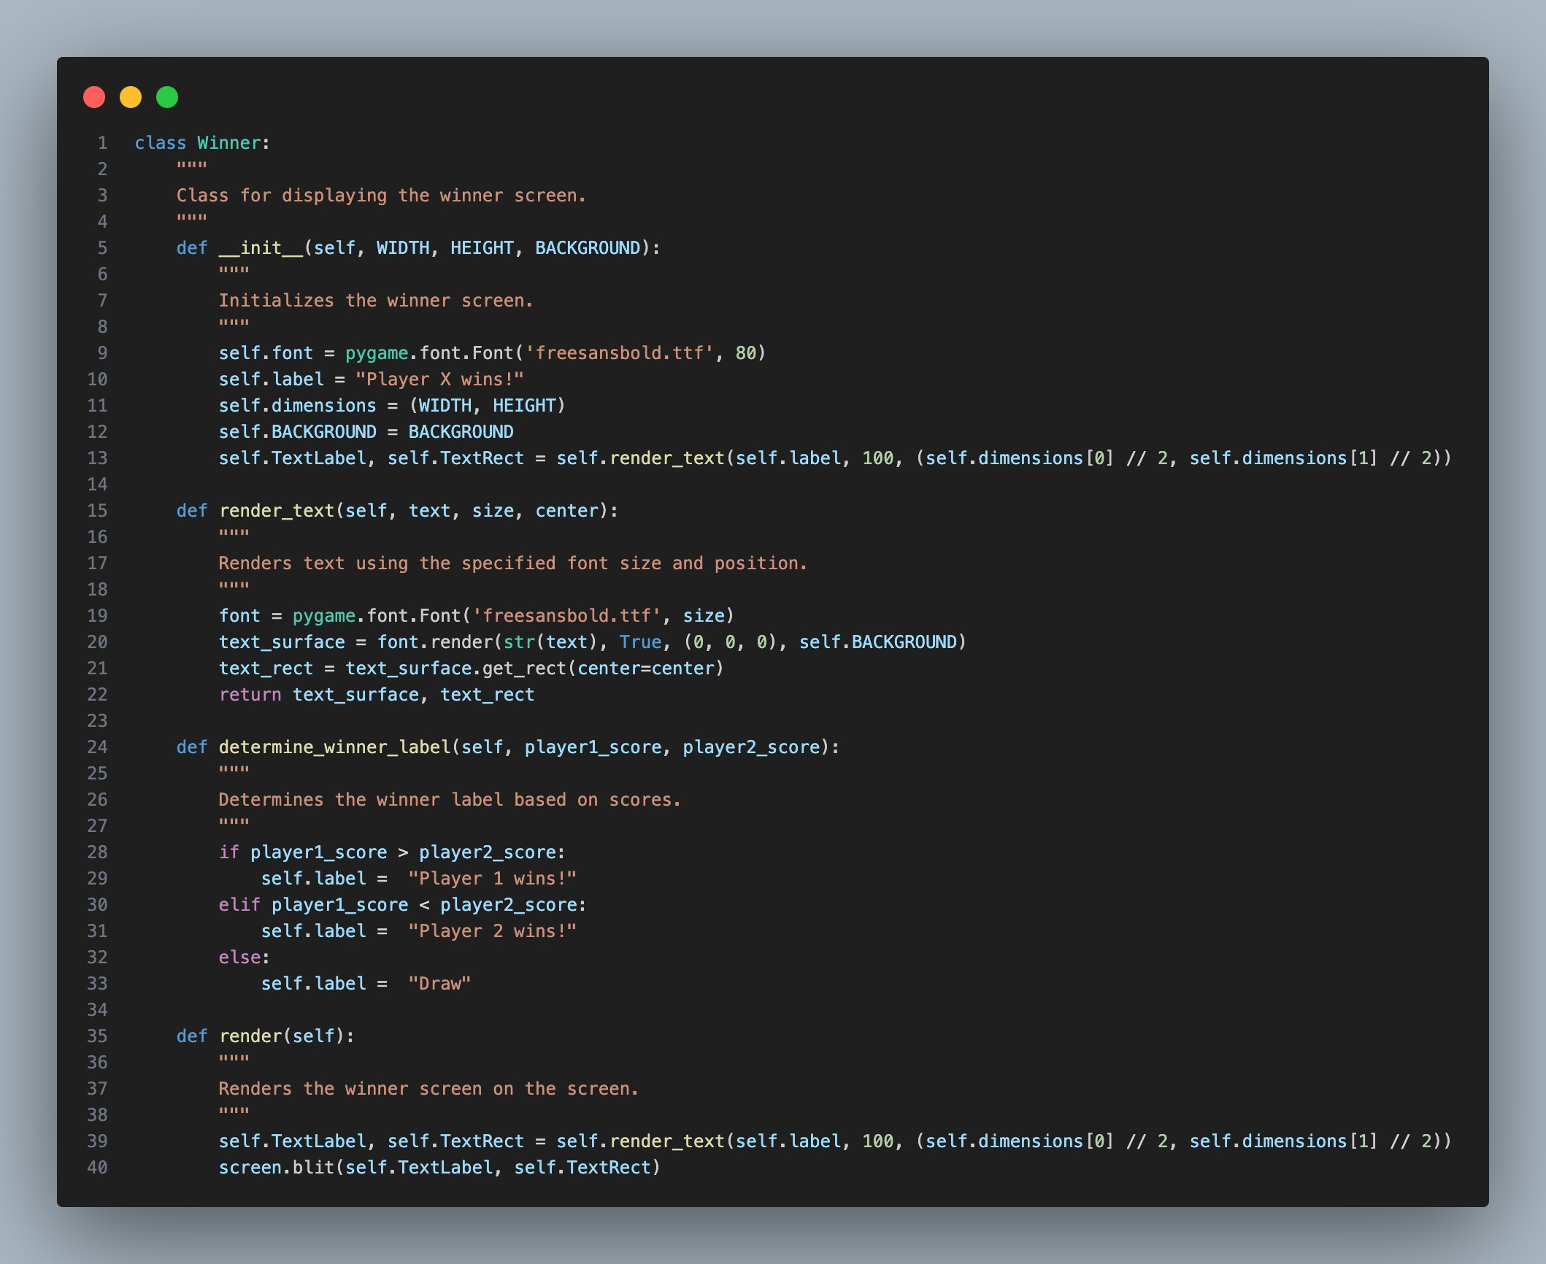
Winner Screen
Declares the winner of the game.
Displays the label "Winner" along with the winning player or a draw message.
Celebrates the victor of the quiz.
Player 1
Wins!
14
Winner Screen
Notes:
Poppins Light – 18 size

